Slide 1
Christmas in English-speaking countries

Slide 2
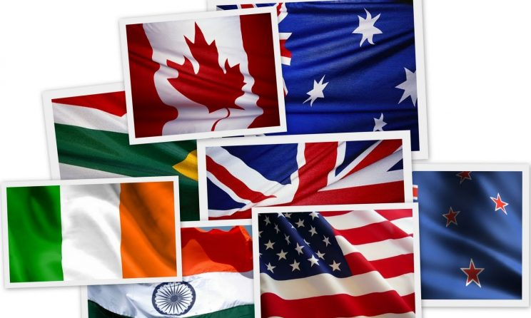
English-speaking countries:
-United States -United Kingdom
-Ireland -Australia
-Canada
-New Zealand

Slide 3
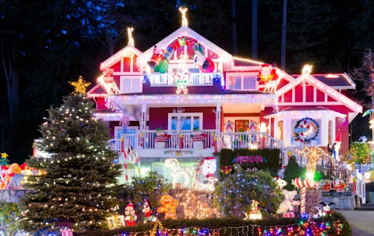
United States
Traditions:
decorating Christmas tree
home dressing
-giving gifts to the family

Slide 4
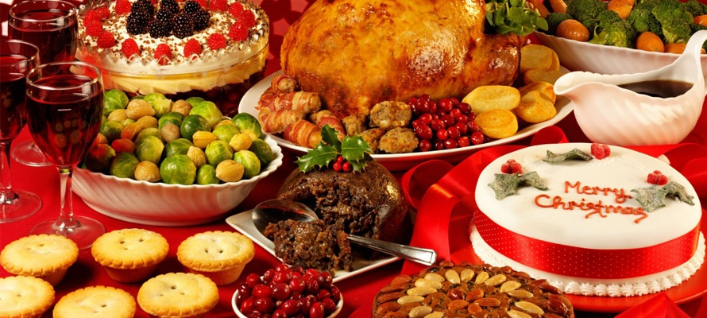
United States
Meals:
-Christmas dinner
-ham or turkey
-cheese cake
-apple juice

Slide 5
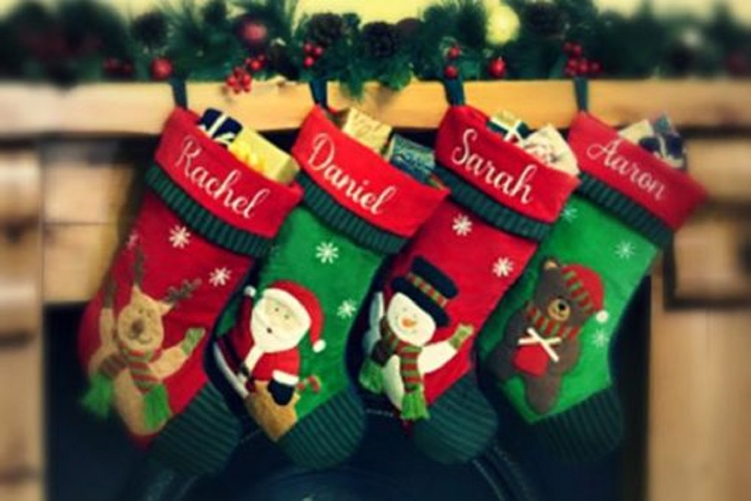
United Kingdom
Traditions:
-gifts in socks
-greeting cards
-Christmas carols

Slide 6
United Kingdom
Meals:
-Christmas pudding
-turkey
-cake with meat

Slide 7
Ireland
Traditions:
-Christmas tree
-Christmas preparations

Slide 8
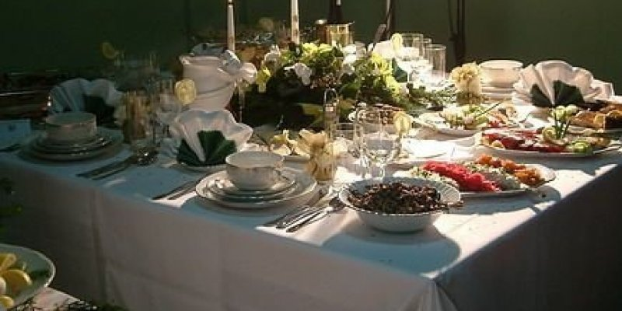
Ireland
Meals:
-turkey
-ham
-salmon

Slide 9
Australiaa
Traditions:
-artificial Christmas tree
-Christmas party
-Christmas is summer

Slide 10
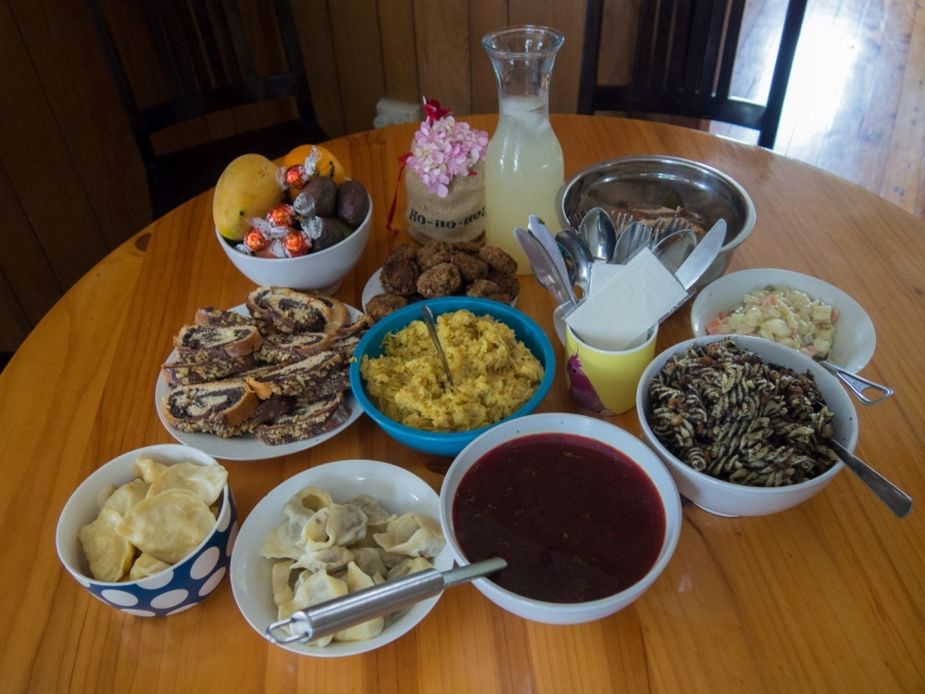
Australiaa
Meals:
-Baked Potatoes
-turkey
-lamb

Slide 11
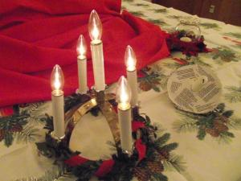
Canada
Traditions:
-prayer in the Church
-festive meal

Slide 12
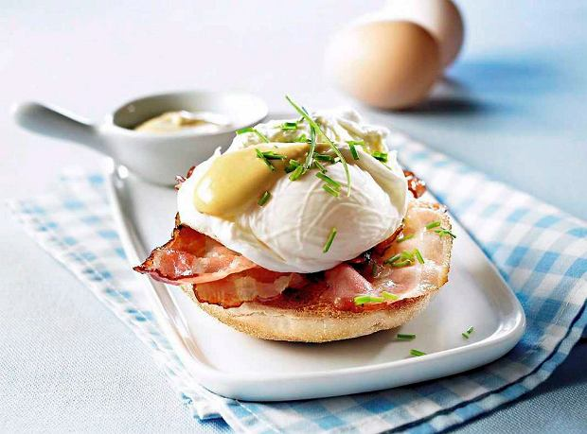
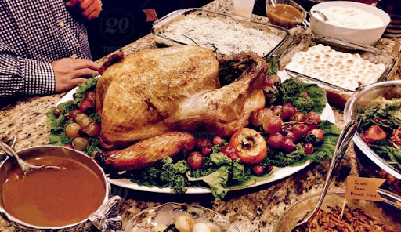
Canada
Meals:
-baked turkey
-beef
-pudding

Slide 13
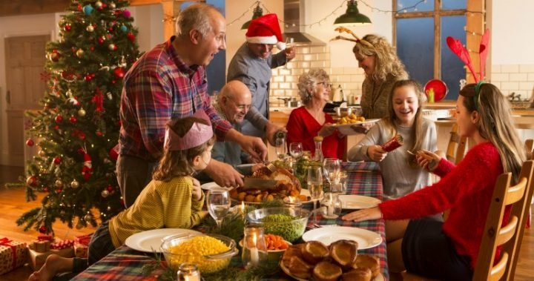
New Zealand
Traditions:
-Dinner together
-Christmas tree

Slide 14
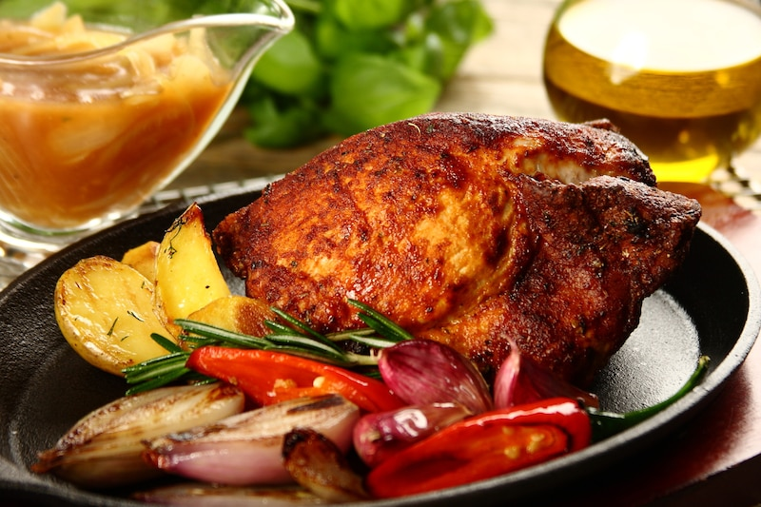
New Zealand
Meals:
-ham
-turkey
-baked vegetables
-sweet pudding

Slide 15
Thank you for attention
Informations from:
Google photos and wikipedia.
Łukasz Miśkiewicz

