Slide 1
Christmas in English-speaking countries
Author: Marlena Wicher

Slide 2
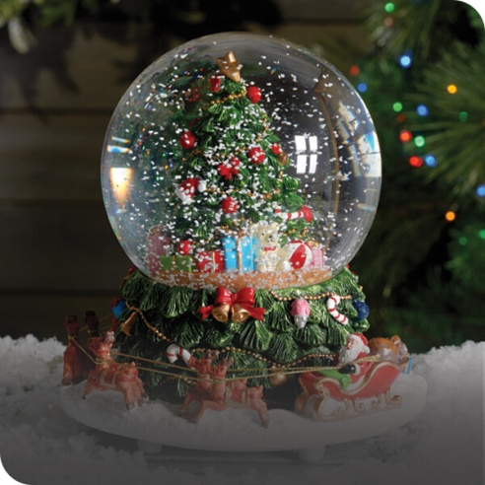
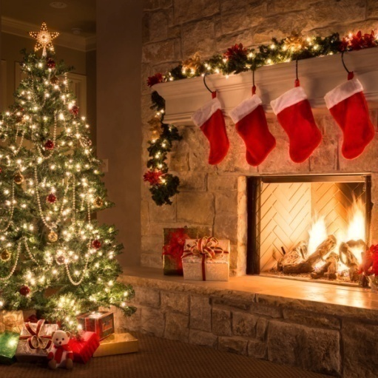
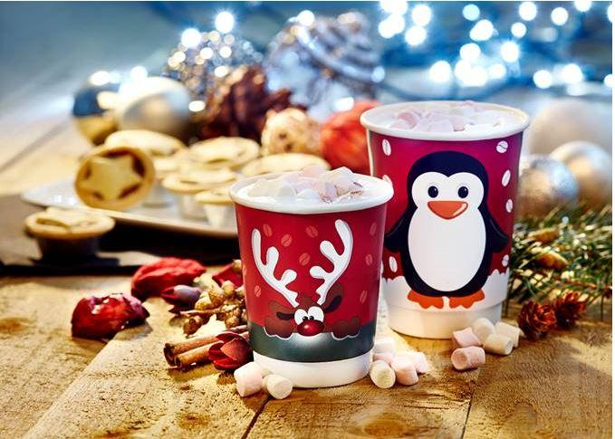
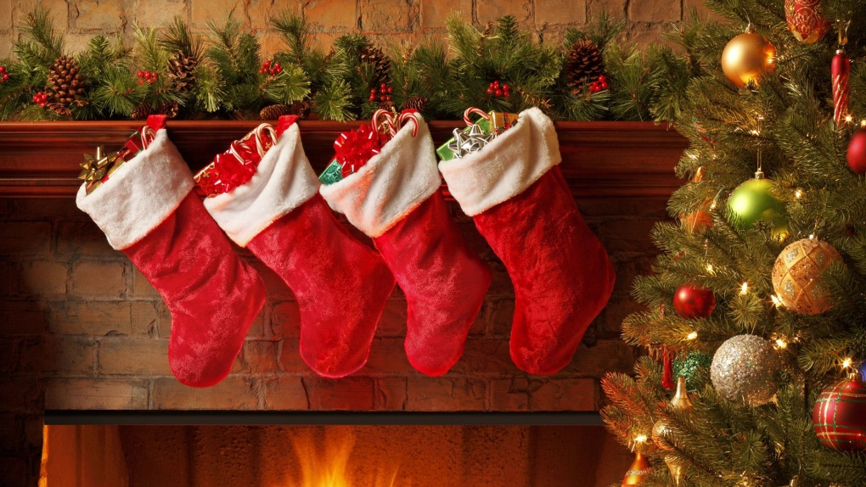
Some Christmas pictures

Slide 3
Which countries are English-speaking?
The English-speaking countries belong:
the United Kingdom,
the United States,
Australia,
New Zealand,
Canada (without Quebec),
Ireland (without Gaeltacht),
South Africa (without Volkstaat)

Slide 4
A description of Christmas in Great Britain

Slide 5
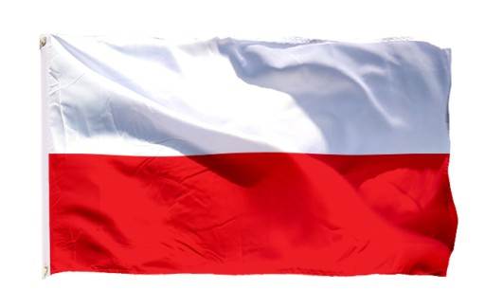
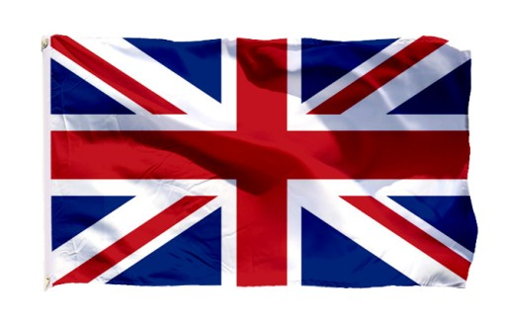
What are the differences in celebrating Christmas in Poland and in Great Britain?
In Poland, the most important day of Christmas is December 24, Christmas Eve. There is no such thing in the UK, for the British it is a normal day (the only thing they do that day is hanging their socks on the fireplaces), and they start the celebration on December 25 with a festive dinner with family or friends. Such celebrations are often organized in restaurants, which is unthinkable for us Poles.

Slide 6
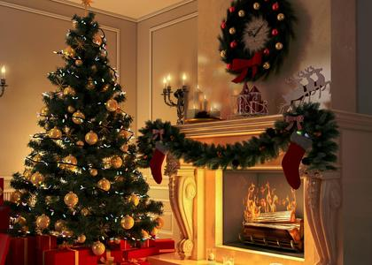
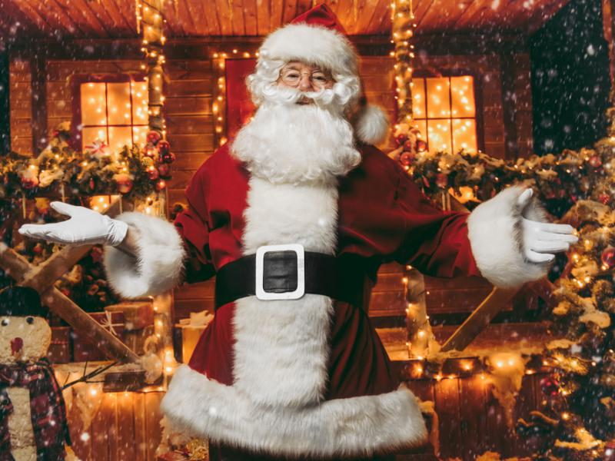
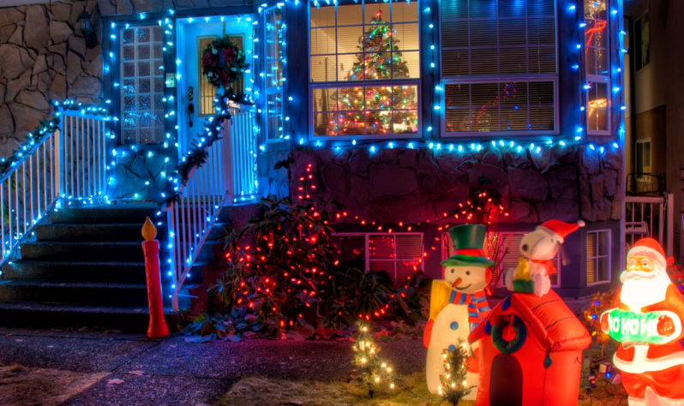
Christmas atmosphere, Christmas tree
In Great Britain, the Christmas atmosphere begins as early as mid-November and disappears right after New Year's Eve. In Poland, the Christmas tree is traditionally dressed on Christmas Eve or a few days earlier and decorates the house until February. The British love Christmas decorations. Santa Clauses, reindeer, gifts, big socks - you can see them everywhere! They decorate houses and gardens. Lights shine everywhere!

Slide 7
What do British people eat on Christmas?
Polish Christmas Eve cannot take place without carp, it should have twelve dishes. In contrast, the traditional Christmas meal in Great Britain is stuffed, roasted turkey. Apparently, preparing one is quite a challenge, baking it takes up to 5 hours!
wafer, sharing wafer, Christmas Eve
The British don't share the wafer. It is a beautiful Polish and Catholic tradition. However, "Christmas Crackers" are popular, it is not a compulsory element on the holiday table and has little to do with the wafer, but it often appears at Christmas dinners.

Slide 8
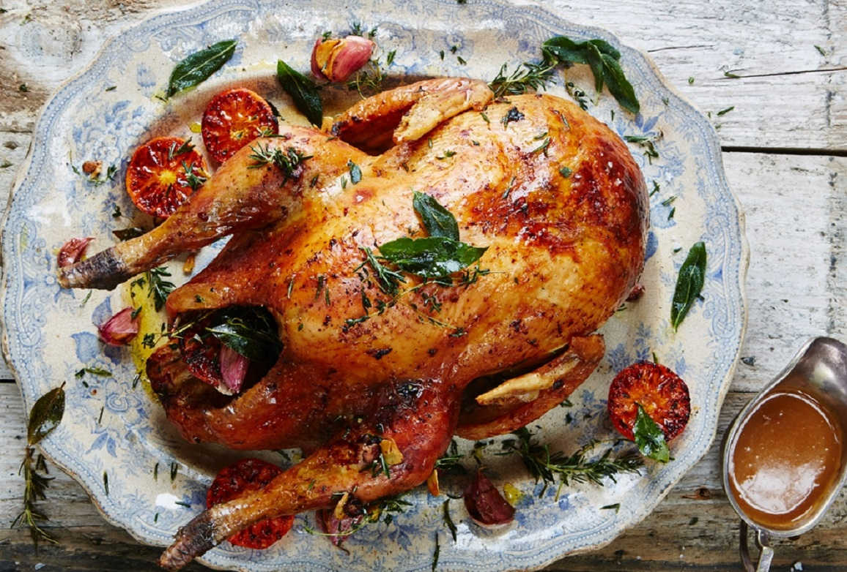
Stuffed, roasted turkey

Slide 9
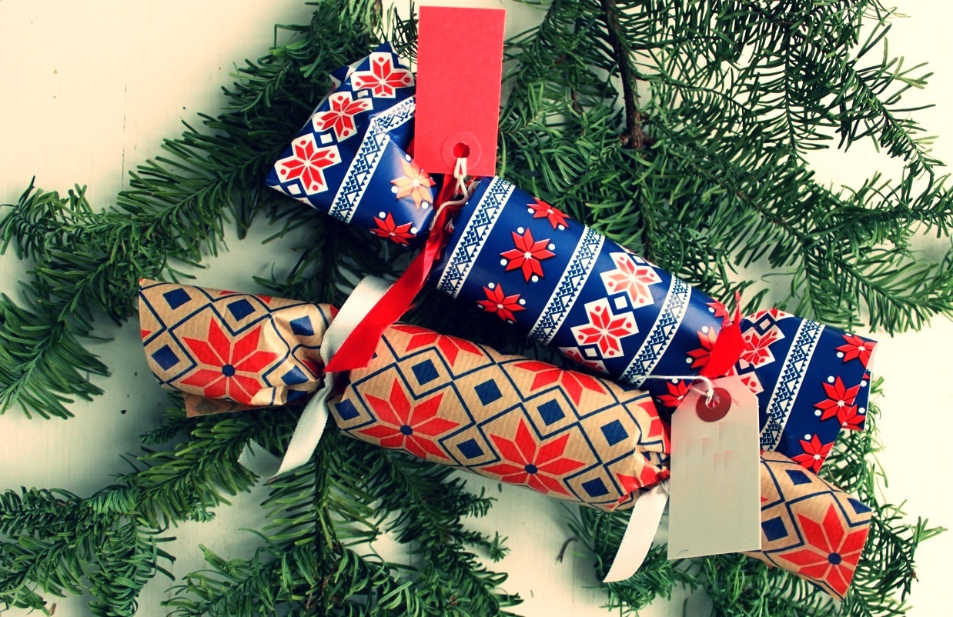
What are "Christmas Crackers„?
These are large, decorative, paper candies (there is nothing sweet inside) that two people tear apart by pulling them towards each other. Tearing it apart is signaled by a rather loud explosion, and inside we can find a small surprise, such as a paper crown for the head, a fortune card or something similar.

Slide 10
Sweets, snacks in the UK
Poppy seed cake and cheesecake must be obligatory on Christmas in Great Britain.
The English have several typically Christmas desserts. They are all very characteristic and you cannot pass by them indifferently. Either you like them or you hate them.
*English desserts on the next slide*

Slide 11
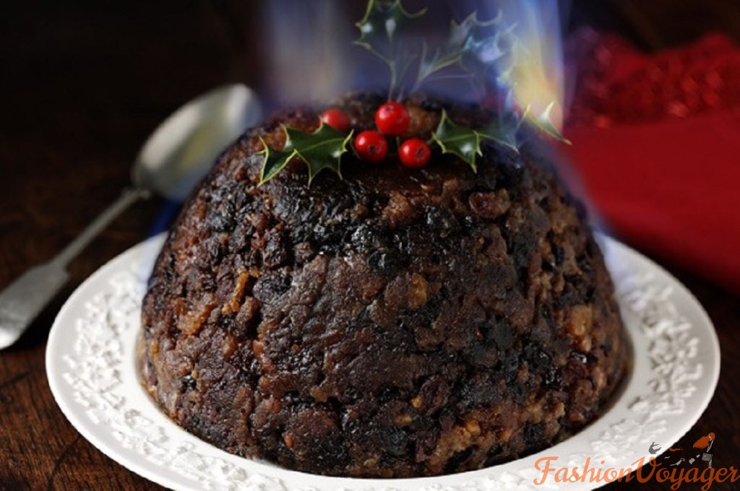
The first dessert is Christmas pudding
It is a dark cake soaked in alcohol with a lot of dried fruit. They are prepared a lot before Christmas, because they "mature" for about five weeks

Slide 12
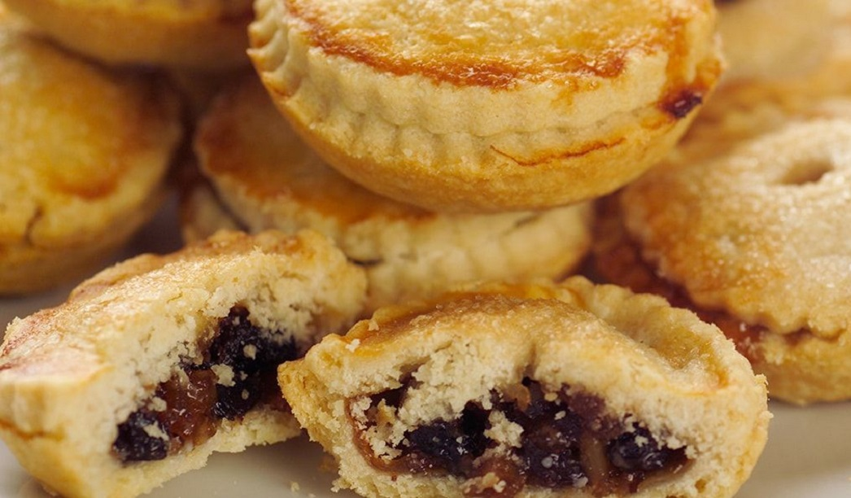
The second dessert is mince pies. Mince pies are small cupcakes filled with a very sweet mass of nuts and raisins

Slide 13
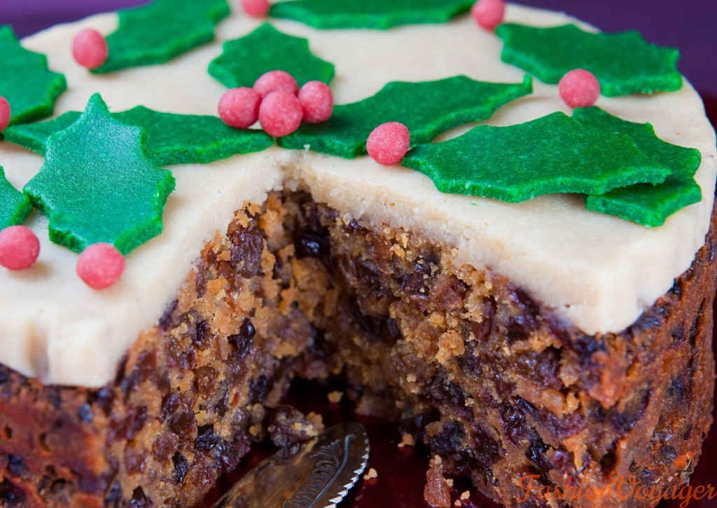
The third dessert is the christmas cake. It is a special Christmas cake prepared just like Christmas pudding, long before Christmas.

Slide 14
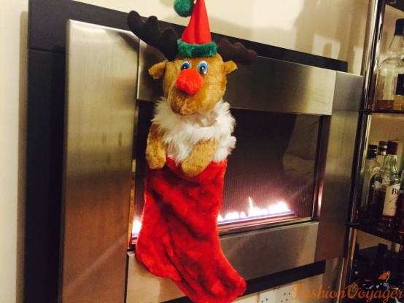
What about UK gifts?
In Poland, they go to the Christmas tree, and only after eating, they are distributed to the household. In Great Britain, opening gifts is very much celebrated. Santa leaves gifts at night in specially prepared socks, which are hung on the fireplace. What does not fit them goes under the Christmas tree. Each of the gifts is opened individually, you cannot fail to admire what you got. During the course, the famous English tea is sipped. Such traditional English gift opening can go on all evening.

Slide 15
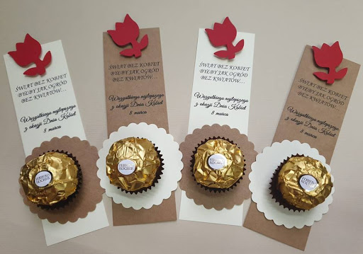
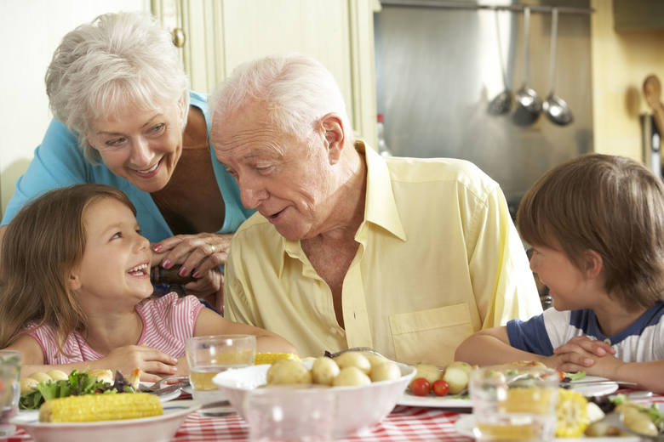
What is celebrated on December 26 in UK?
December 26 is the so-called "Boxing Day" in Great Britain. The name comes from the gift boxes that were traditionally given to traders, servants and friends. On this day, as in Poland, family and friends are visited.

Slide 16
END OF BRITISH CUSTOMS

Slide 17
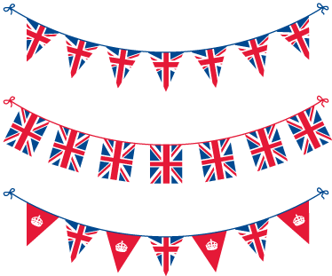
In this presentation, I only presented the traditions of Great Britain because many English-speaking countries have similar traditions

Slide 18
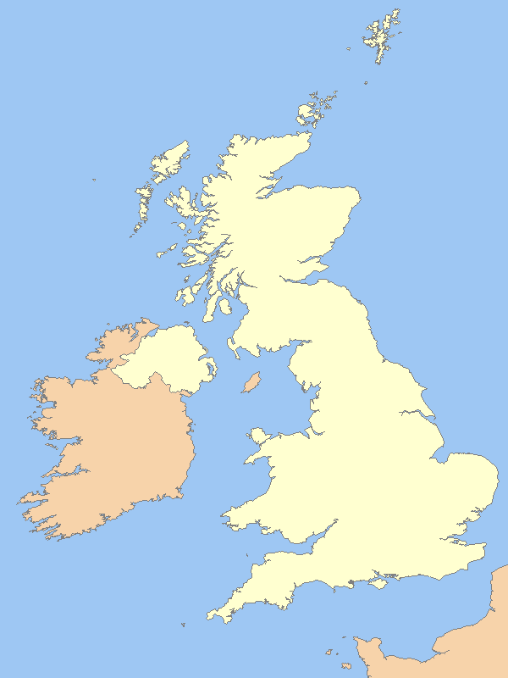
Finally, a reminder of where the United Kingdom is
Uk is a bright yellow color

Slide 19
Now it's time for the quiz
*questions and answers will be in Polish*

Slide 20
Pytanie 1: Czy Australia należy to krajów anglojęzycznych?
Tak
Nie
Nie było takiej informacji w prezentacji
Nie wiem

Slide 21
Pytanie 1: Czy Australia należy to krajów anglojęzycznych?
Tak
Nie
Nie było takiej informacji w prezentacji
Nie wiem

Slide 22
Pytanie 2: Co robi się 24 grudnia w Wielkiej Brytanii?
Jest obchodzona wigilia
Trzeba iść na 2 msze Święte
Trzeba ubrać choinkę i wystroić dom
Jest to zwykły dzień

Slide 23
Pytanie 2: Co robi się 24 grudnia w Wielkiej Brytanii?
Jest obchodzona wigilia
Trzeba iść na 2 msze Święte
Trzeba ubrać choinkę i wystroić dom
Jest to zwykły dzień

Slide 24
Pytanie 3: W Polsce we Wigilię bardzo często przyrządzamy karpia, natomiast w UK…
Ciasto z orzechami
Gotowanego kurczaka
Pieczonego kurczaka
Pieczonego pstrąga

Slide 25
Pytanie 3: W Polsce we Wigilię bardzo często przyrządzamy karpia, natomiast w UK…
Ciasto z orzechami
Gotowanego kurczaka
Pieczonego kurczaka
Pieczonego pstrąga

Slide 26
Pytanie 4: Co robią Brytyjczycy zamiast opłatka?
Robią sobie Christmas Crackers
Pieką sernik
Robią Christmas pudding
Robią mince pies

Slide 27
Pytanie 4: Co robią Brytyjczycy zamiast opłatka?
Robią sobie Christmas Crackers
Pieką sernik
Robią Christmas pudding
Robią mince pies

Slide 28
Pytanie 5: Co dzieje się w Wielkiej Brytanii 26 grudnia?
Brytyjczycy ubierają choinkę
Dają sobie upominki
Dzwonią do siebie i składają sobie życzenia
Odwiedzają swoją rodzinę i swoich przyjaciół

Slide 29
Pytanie 5: Co dzieje się w Wielkiej Brytanii 26 grudnia?
Brytyjczycy ubierają choinkę
Dają sobie upominki
Dzwonią do siebie i składają sobie życzenia
Odwiedzają swoją rodzinę i swoich przyjaciół

Slide 30
This is the end of the quiz and the end of the presentation, thank you for your attention

